Slide 1


THE RACQUETEERS
SUMMER OF 2021

Slide 2
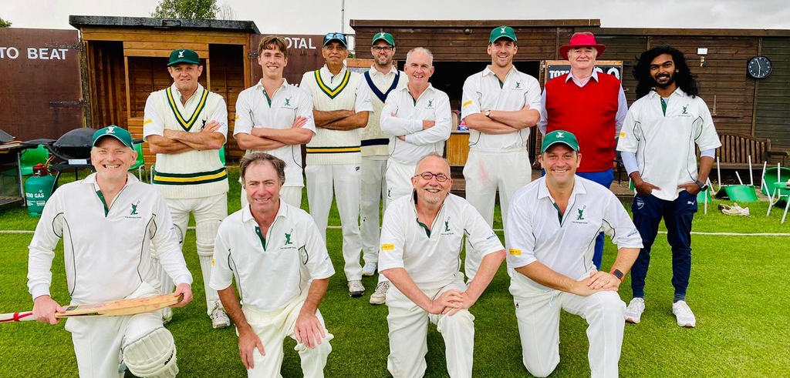
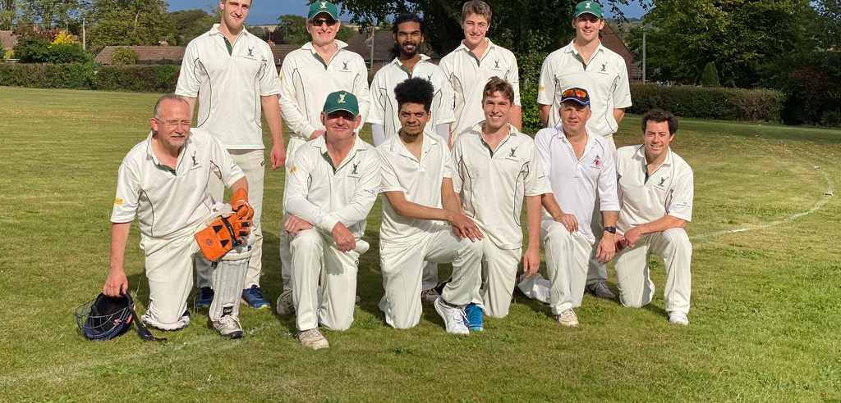
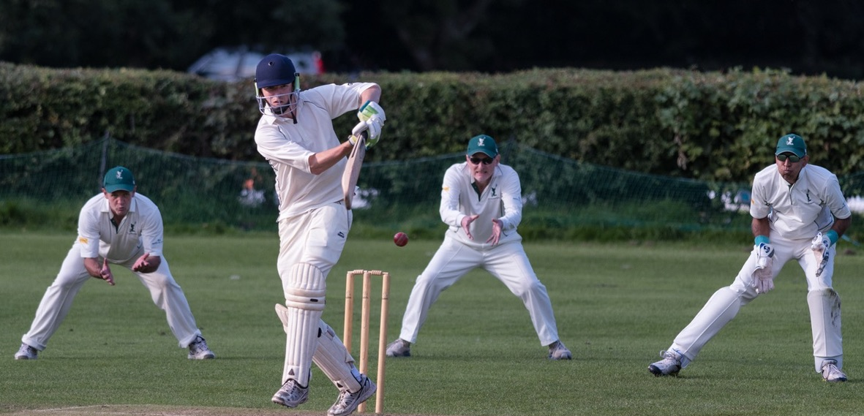
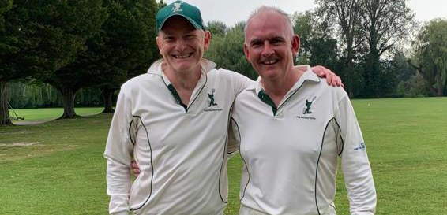
THE RACQUETEERS

Slide 3
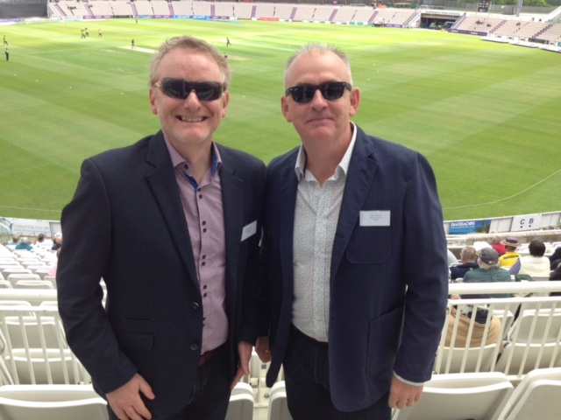
THE RACQUETEERS | CAPTAIN’S REPORT 2021
How nice to be able to have this year’s AGM in person, chaps, and with what I’m sure will be an excellent curry to follow, and a chance to reflect on another super summer of Racqueteers cricket! Whilst it was unfortunate to lose several games to inclement weather, as well as being let down by a couple of oppositions teams, we had a full and entertaining season.
I won’t give a blow by blow account of every game, but must just mention a few highlights of a season where (as G’s superb stats so expertly illustrate) we had a fairly even win/loss ratio in some close-fought contests.
It’s been a huge pleasure to welcome Yox, Rishi, Stoppers and Greg to the Racqueteers fold with all making great contributions to team performances, perhaps most memorably in our brilliant win at St Cross in August; our first trip to the club. It was a day also notable for Kendall’s first and very powerful century on the beautiful local ground. It was also wonderful to share in (including our century opening stand) our esteemed President’s first Racqueteers 50 against Westgate Lambs at River Park which resulted in a decisive 70-run win.
Another magic moment was Luke’s sublime, perfectly pitched and spinning first-ball-of-the-match clean bowling of the White Hunters’ opening bat in our (quickly) rearranged home win against that most affable of oppositions.
Mike C’s 60th birthday was also celebrated in great style against Newport Inn on their bucolic Braishfield ground followed (despite intervening heavy rain) by an excellent bbq courtesy of the Prof’s culinary skills!
It would be remiss not to mention the last game of the season at the quirky Droxford. After some gentle ‘captainly’ persuasion Sepia stepped up (in the absence of G) to keep wicket with great aplomb - not in monastic silence - throwing himself around behind the stumps like a young gazelle, despite constant protestations that he hadn’t kept wicket since 1962! Sorry 1992….
Anyway, it’s an honour and privilege to captain The Racqueteers and this past season has been no exception; especially with all the uncertainty of the early months of 2021. Our excellent friendly cricket - played in the right spirit and on so many wonderful grounds is always a pleasure to play and I hope you’ve all enjoyed it as much as I have.
I also know you’ll all want to join me in saying a huge ‘thank you’ to Mike for his tireless hard work on behalf of the Club, as well as his immense effort to keep the Pavilion Project on track. More of that in an update a bit later…
Here’s to an even fuller fixture card (with some exciting new fixtures to come in 2022) and to further success on the field, always combined with our wonderful Racqueteers camaraderie and friendship off the field. Thank you all.

Slide 4
THE RACQUETEERS | PRESIDENT’S MESSAGE
Thanks for your excellent summary of our season, Mike! Despite losing a third of our fixtures to the weather or lack of opposition, it is nice to be able to reflect on a full season’s cricket after the truncated season we had last year.
My memory of the ’21 season is of one that the stats do not reflect. I don’t for one moment question the stats – and thank you, as ever, G, for the fabulous stats you’ve produced not only for the season report but also after every single match of the season – I just feel our cricket was a lot better than it appears on paper! Four wins from our twelve matches played simply feels wrong. Our two “NRs” (no result) would have undoubtedly ended in Racqueteers’ victories had the rain not intervened. Our matches against the Winchester Nepalese and Crawley Crows were extremely close and could so easily have ended in a different result.
But, of course, it’s not all about winning… We did, however, play some very good cricket – with some excellent individual performances – and can be proud of our record this season. This record has been ably assisted by the introduction of several new talented players this year: Rishi, Stoppers, Yox, and Greg – and we also welcome Guy Sheppard, who was all set to play his inaugural match against the Hospital; sadly another cancelled fixture. Guy and his family moved into the house next door back in September; it had been flagged up to me by the previous owner that Guy was a cricketer – The Racqueteers recruiting machine went into overdrive… We look forward to you joining us next season, Guy.
Nuns Road now contains five Racqueteers: Me, Guy, Stoppers, Edmund and Julien. Saxon Road gives us the redoubtable conversation of Talks - Lawrence, Harry, Charlie and Tom – and Monks Road provides us with Mr Lamb, Greg and Nick. Yox isn’t far away in King Alfred Place. This totals half of this season’s playing squad. But despite this centre of extraordinary cricketing excellence, we are always on the lookout for new players to boost our squad numbers and to make my life a little easier during the season! So do, please, continue to spread the Racqueteers word.
It’s great to see so many of you here this evening – I think the largest turnout for one of our AGMs? I’m sure the curry and free beer had absolutely nothing to do with it! So thank you, all, for turning out; not only tonight but throughout the season. I’ve already thanked G for his wonderful stats; thanks must also go to Mike for his captaincy; to Lol for his scoring; to Lyndon for umpiring and creating and managing our website; to our match reporters (Mike F and Guy); to Karl for the excellent match photos, and last – but most definitely not least – to our sponsor, Yellowtail, in the guise of Kevin Chinn! Kevin has very generously secured sponsorship for The Racqueteers for the 2022 season and also provided a few goodies for this evening… Thank you very much, Kevin.
On a personal note, thanks for making my “significant” birthday this year such a special one. I was extremely touched by the wonderful card that Mike produced - and that you all signed - and for the gift of two fabulous books which you so kindly presented to me after the Newport Inn match. Thank you SO much!

Slide 5

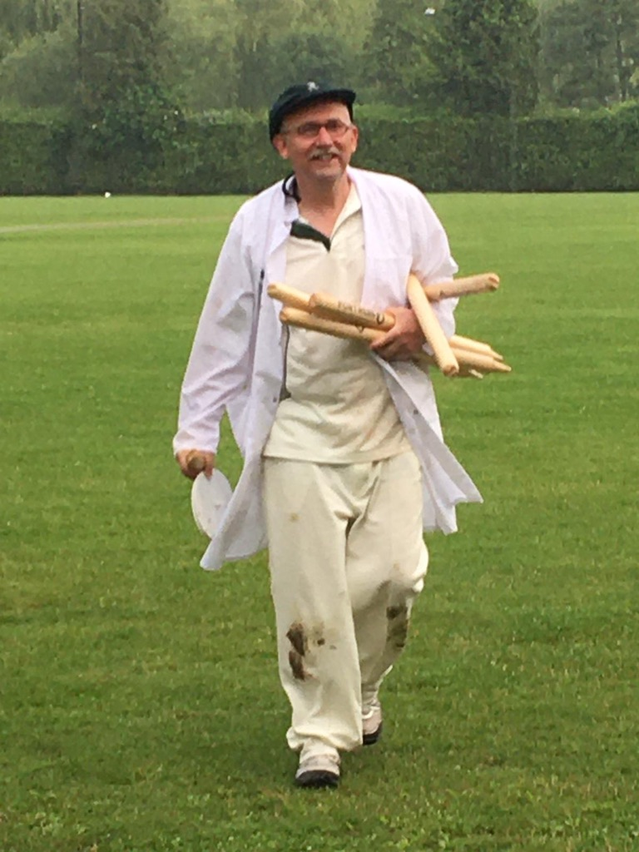
THE RACQUETEERS | MAN OF THE SEASON
This year’s Man of the Season hails from the very epicentre of that centre of cricketing excellence. His house number is “1” and he really is a number one chap. His garden hedge is clipped almost as straight as his bat is held.
Our Man of the Season this year has played in eight of our matches. He umpired one entire match and had to isolate for another (or did we have to isolate him…?!). He’s batted and bowled well, is a frequent attendee at winter training and nets and always has a smile on his worldly-wise face.
In G’s absence, he took the keeper’s gloves at our last match of the season and, as Mike has mentioned, kept wicket like a man an eighth his age. His humorous banter is relentless. He is, of course, Edmund – aka Sepia. Bravo Edmund!

Slide 6
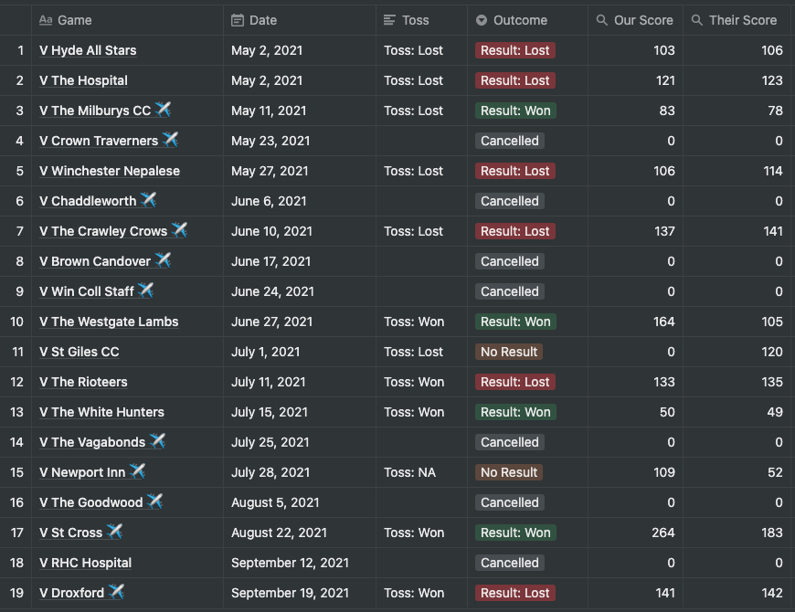
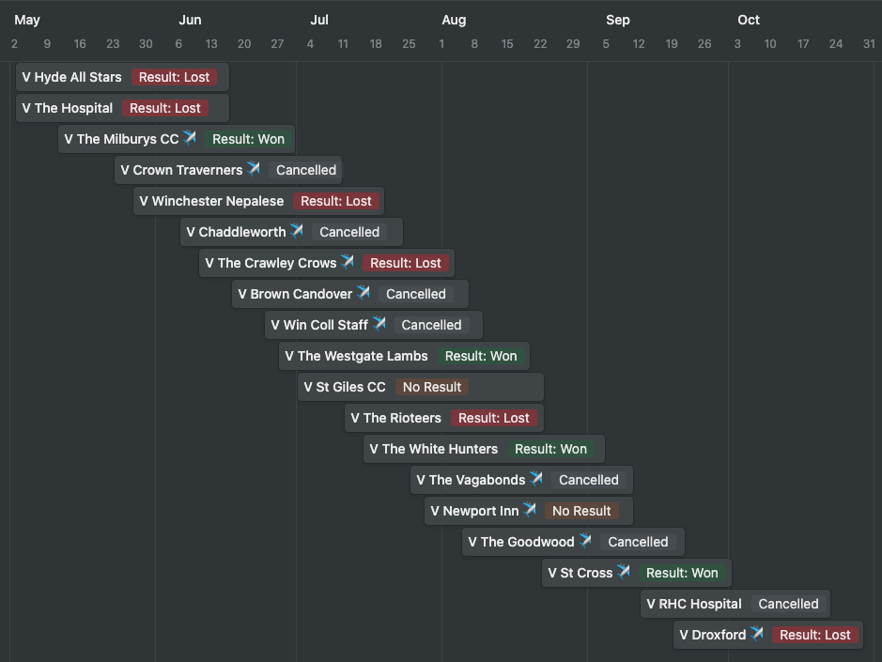
THE RACQUETEERS | SEASON SUMMARY
Win-Loss-NR-DNP: 4-6-2-6 Runs Scored: 1,411 Wickets Lost: 50
Overs Bowled: 243.5 Runs Conceded: 1,228 Wickets Taken: 74
Overs Maiden: 8 CA-RO-ST: 20-6-4 4s-6s: 154-6

Slide 7
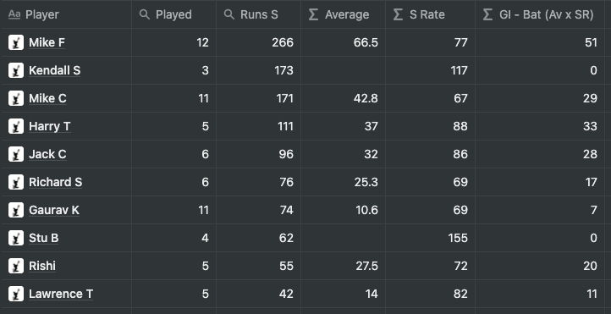
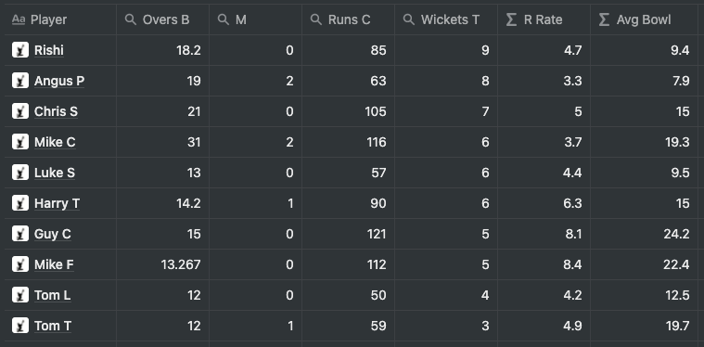
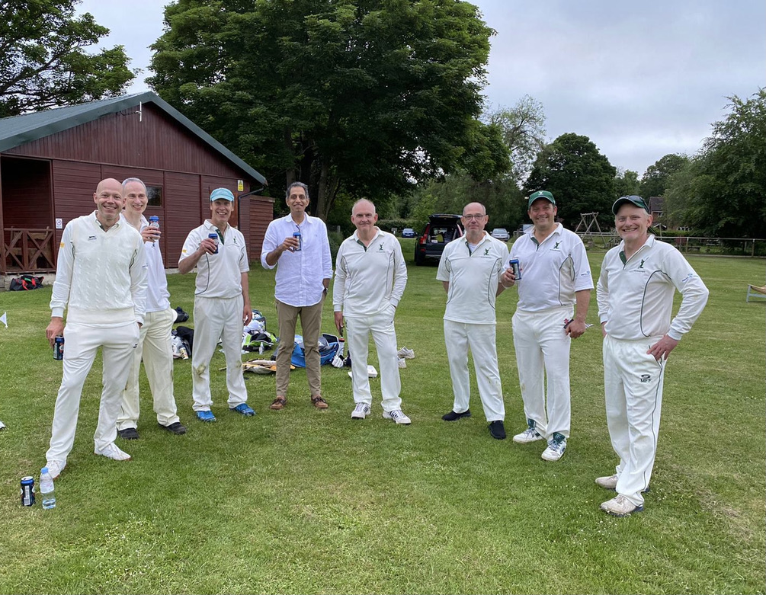
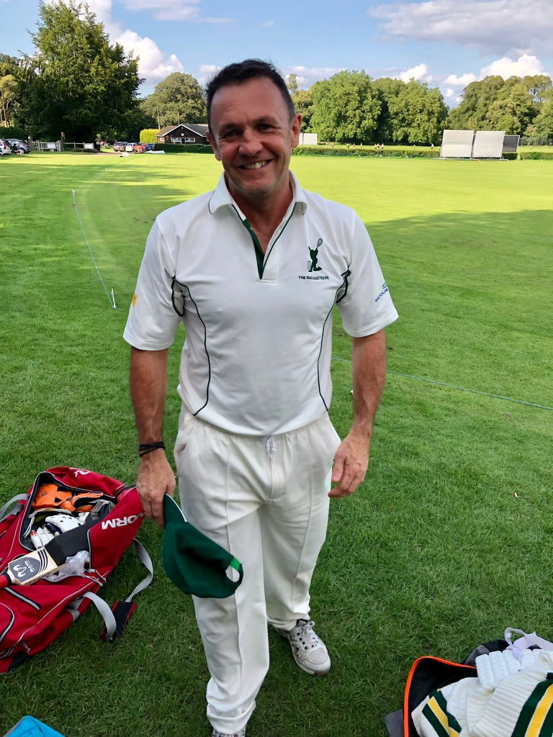
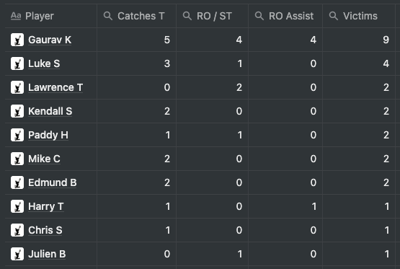
BATTING (TOP 10) BOWLING (TOP 10)
FIELDING (TOP 10)
HS 148*
@St Cross

Slide 8
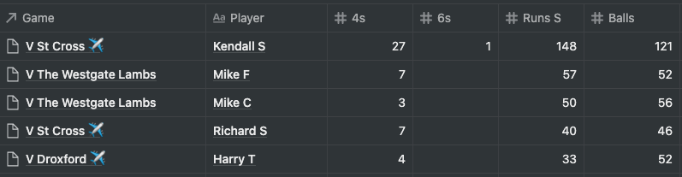
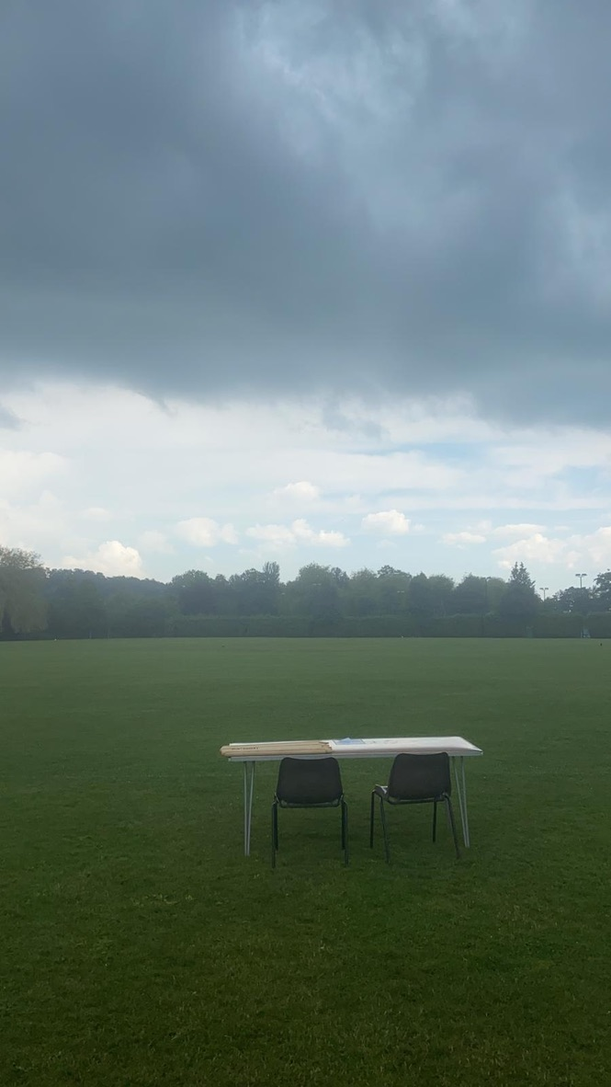
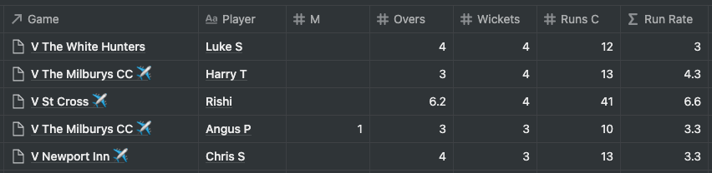
TOP 5 INDIVIDUAL INNINGS
BATTING
BOWLING
HS 148*
@St Cross

Slide 9
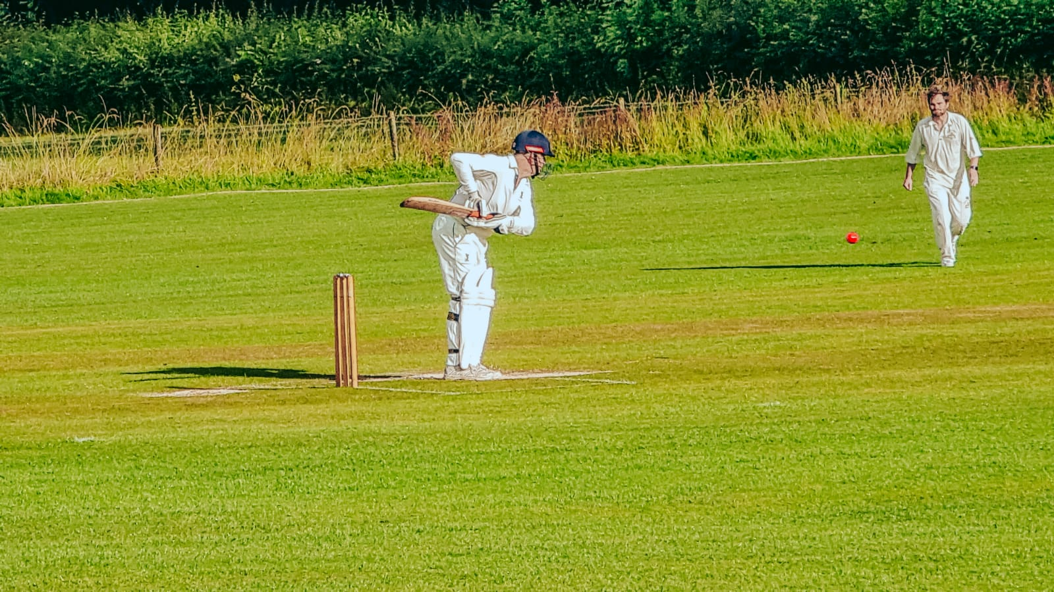
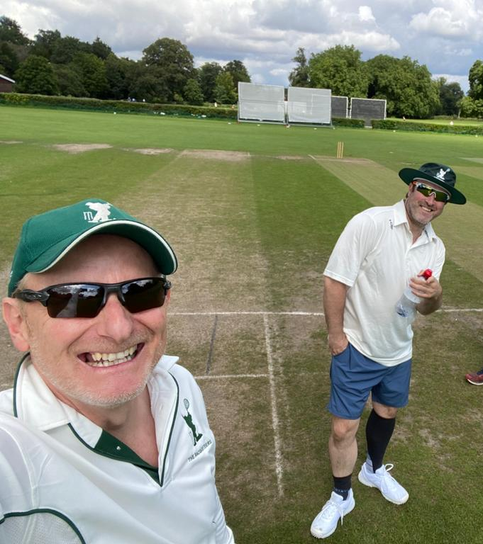
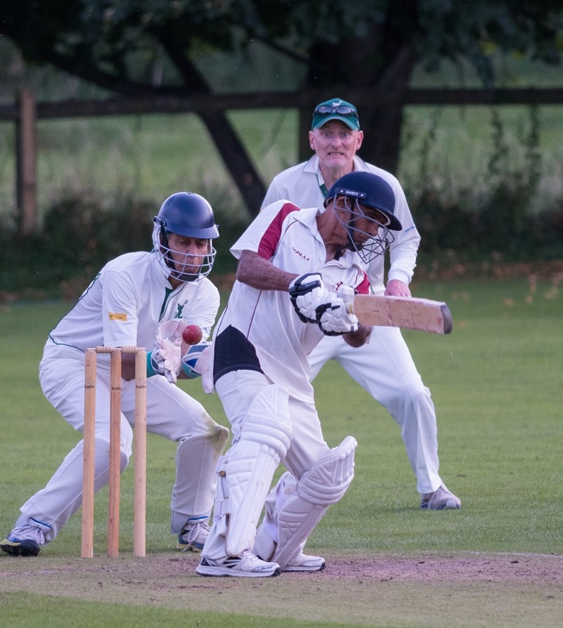
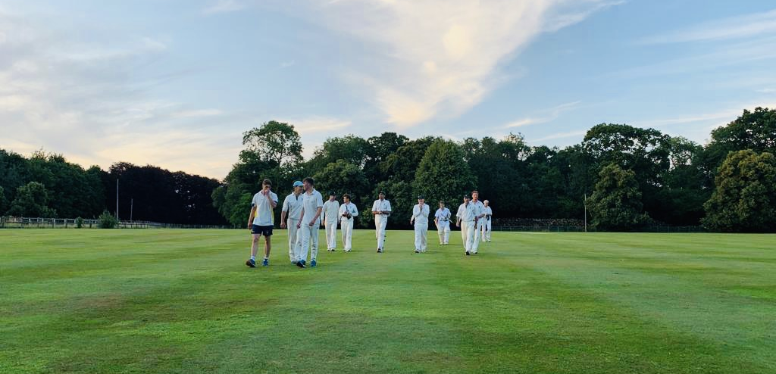
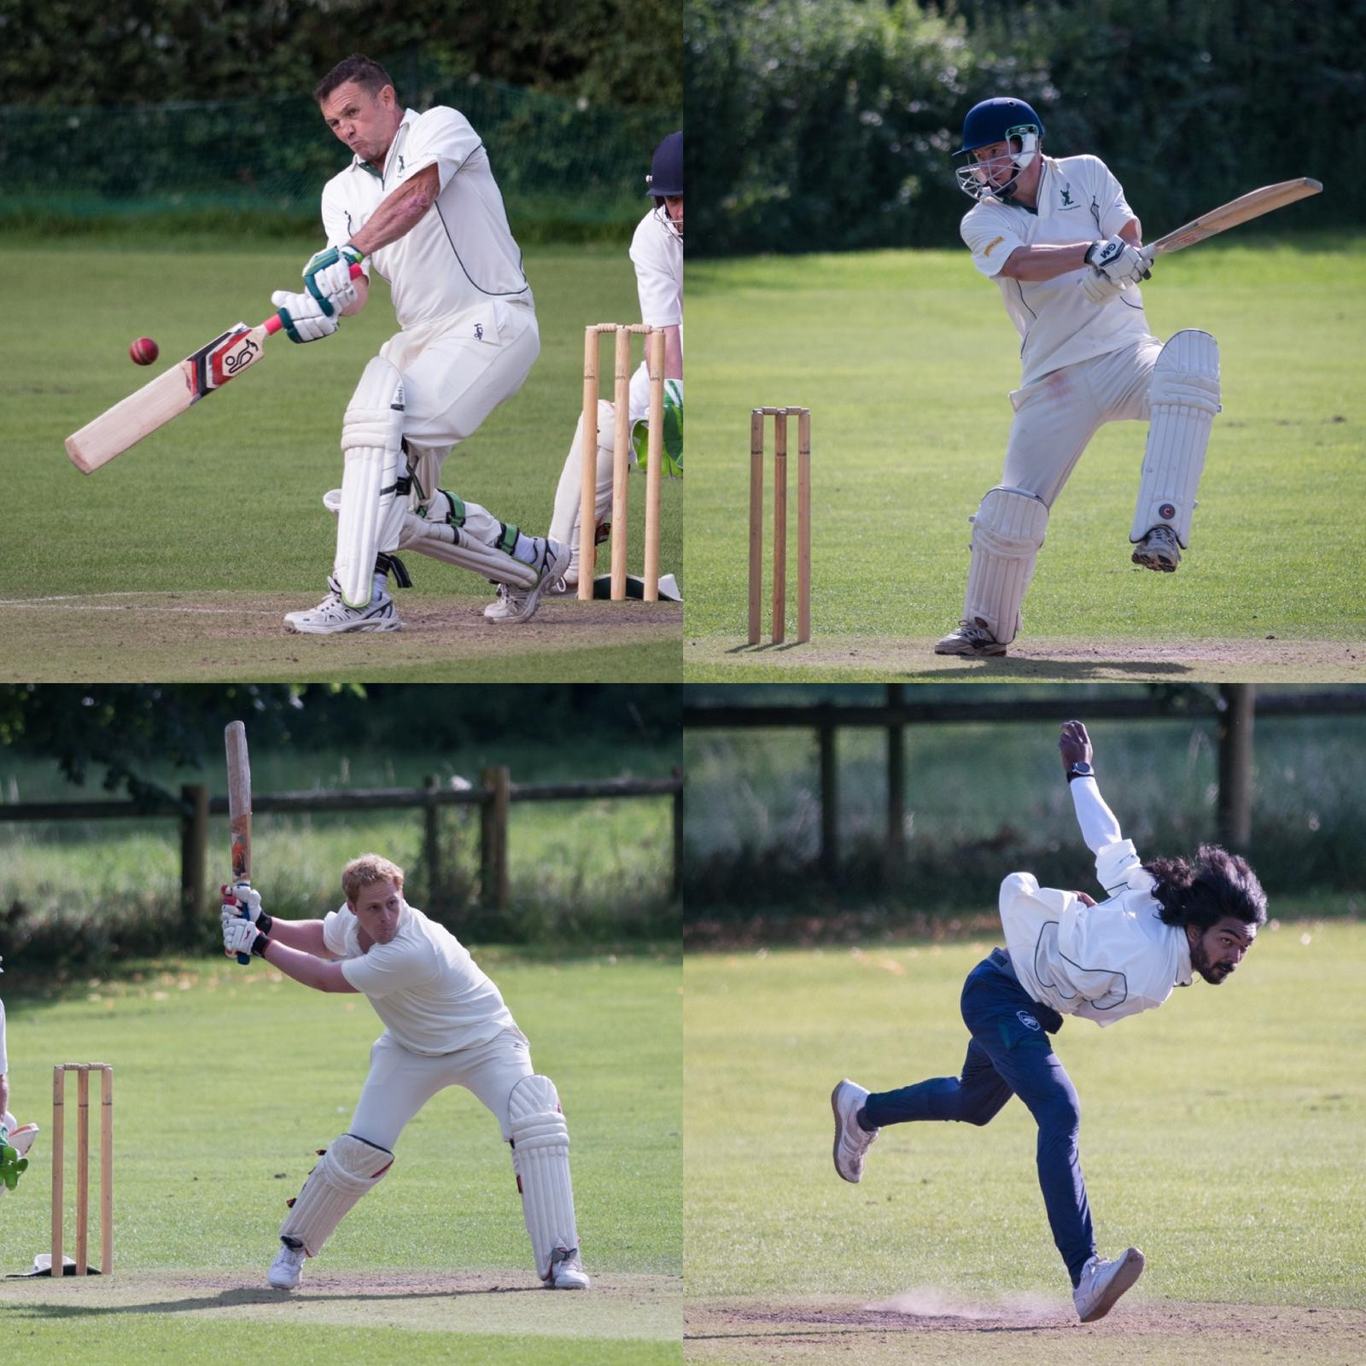
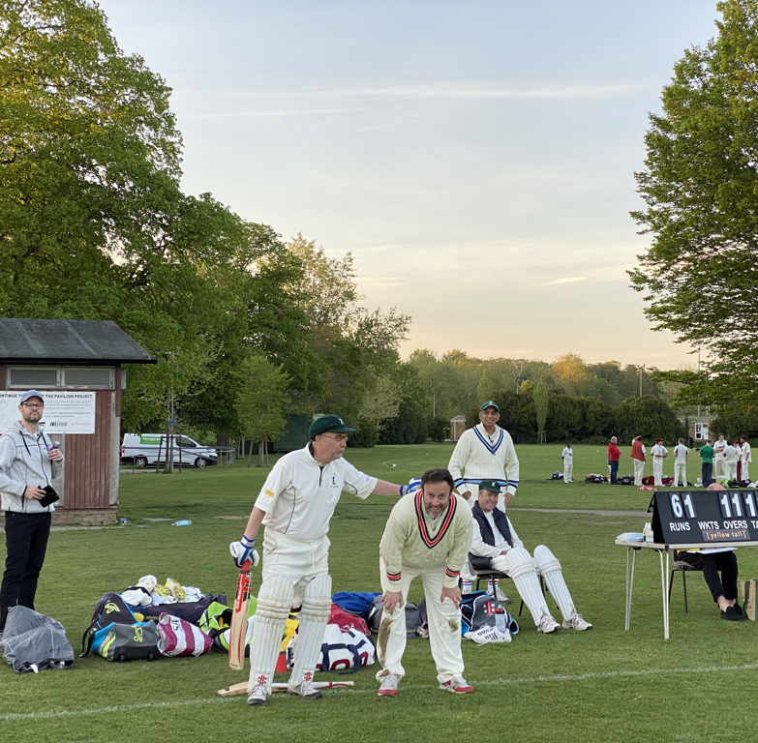
……..ON THE PITCH

Slide 10
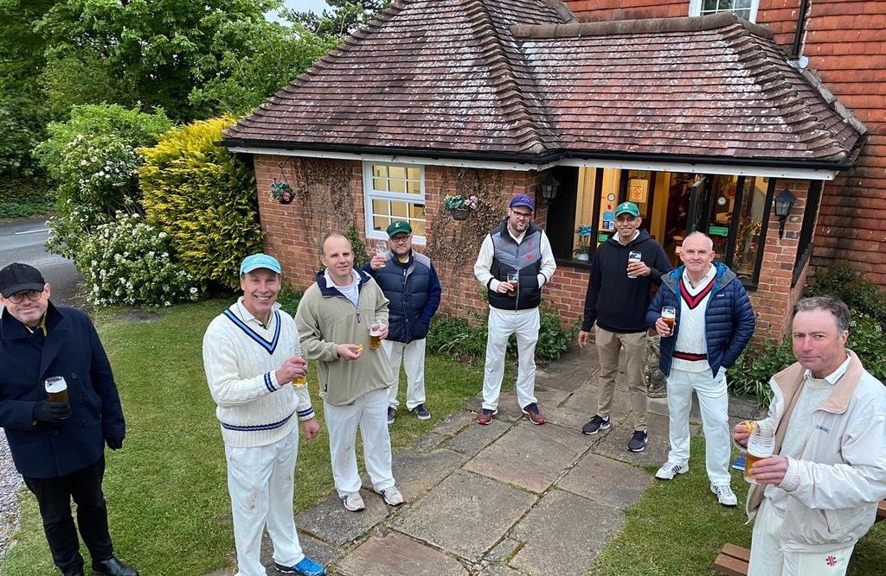
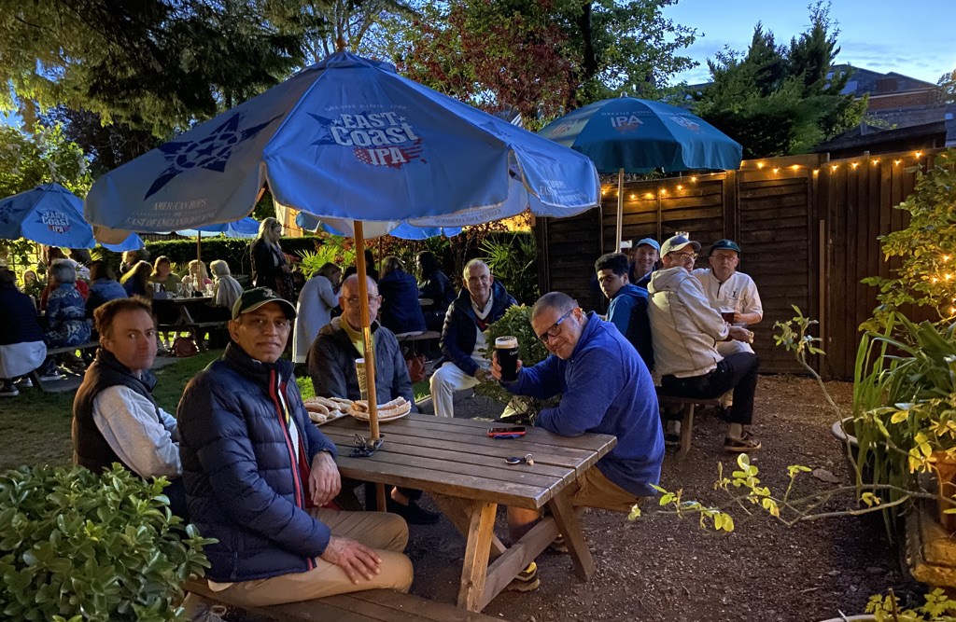
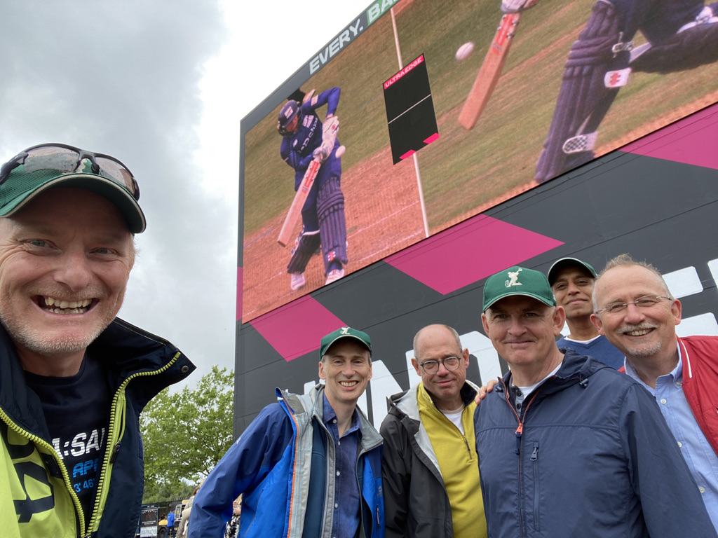
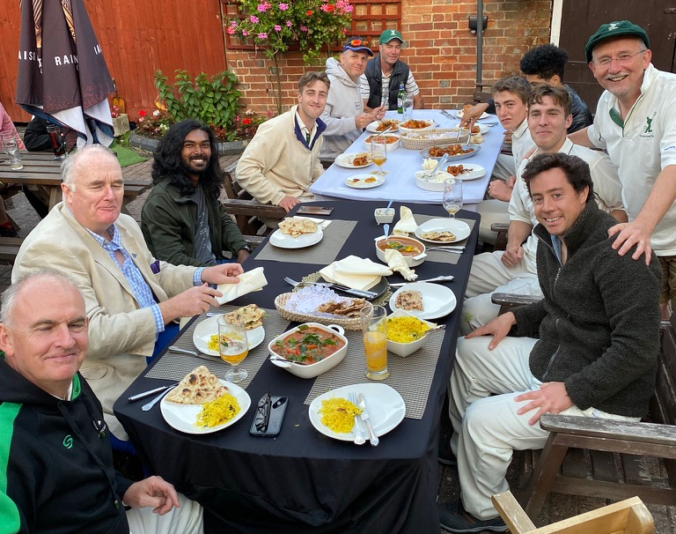
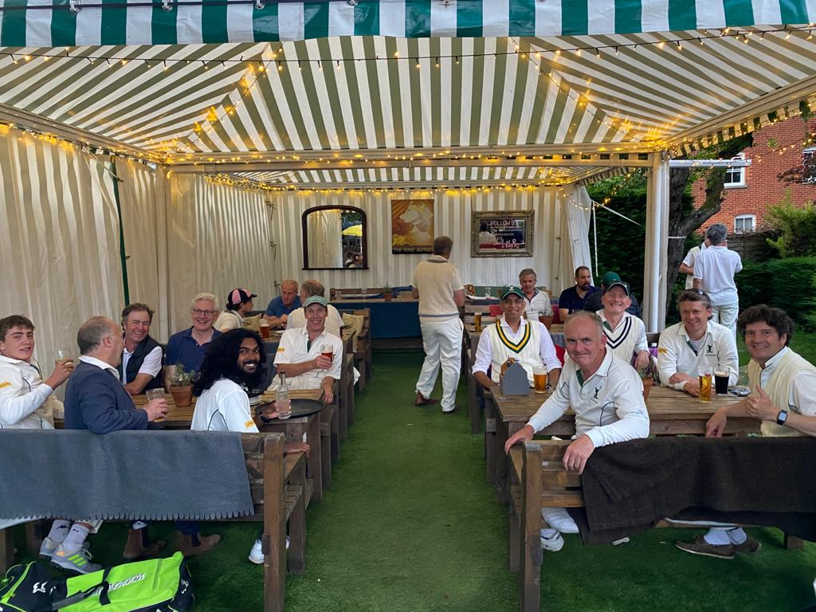
……..OFF THE PITCH

Slide 11
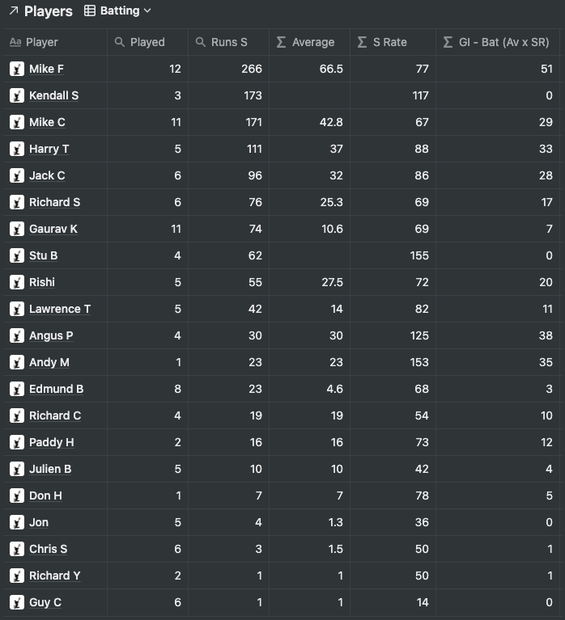
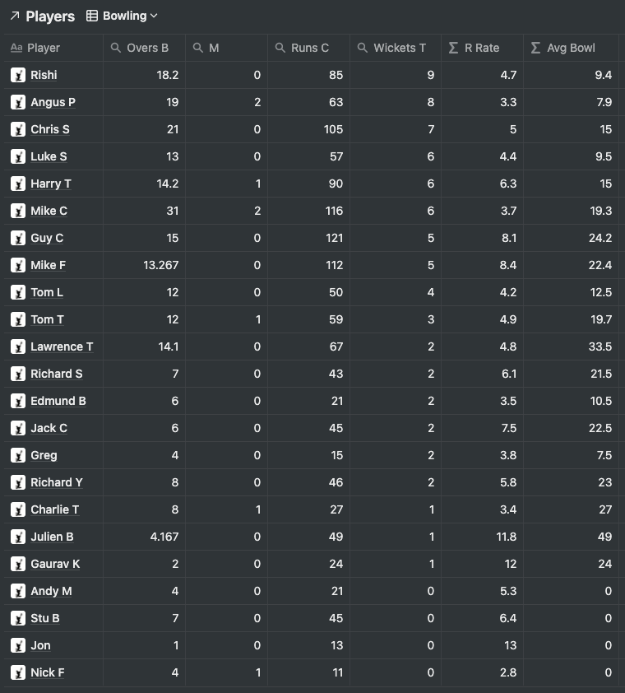
THE RACQUETEERS | ALL STATS – BATTING & BOWLING

Slide 12
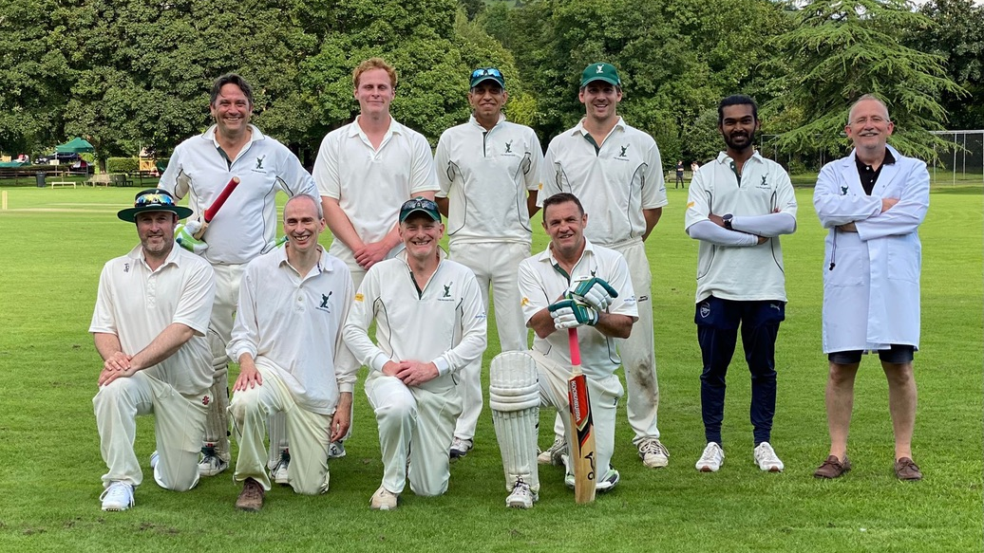
SEE YOU IN 2022…….

